Slide 1

KING’S COUNTY HOUSING ANALYSIS

Slide 2

overview
Uwezo real estate agency deals with homeowners who are either buying or selling houses and they need to advise their clients about which home renovations might significantly increase the value of their homes. Therefore ,our project will help Uwezo company understand and explore which attributes of a home have an impact on the price of a home.

Slide 3

Data and methods
The data used in this project was obtained from sales of homes in King’s County . Exploratory data analysis and modelling was performed on the data.

Slide 4
Results

Slide 5
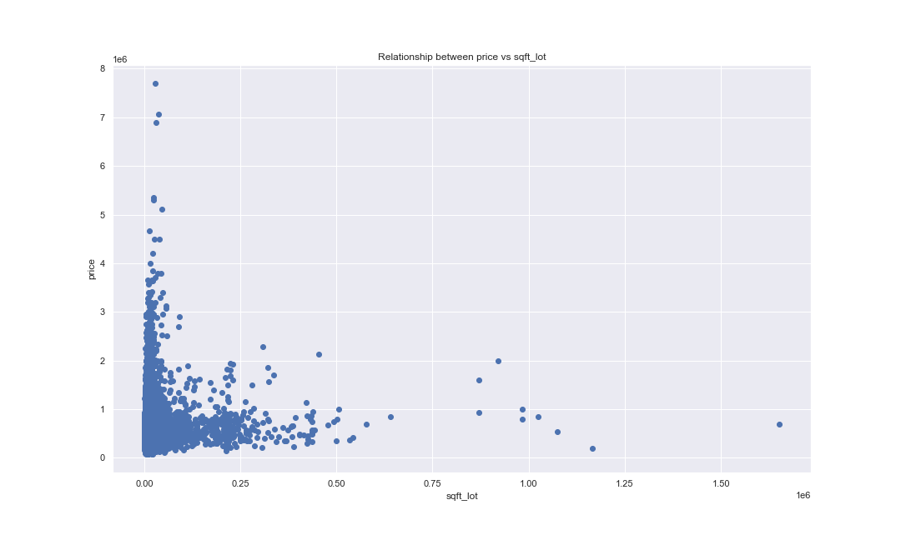
Results

Slide 6
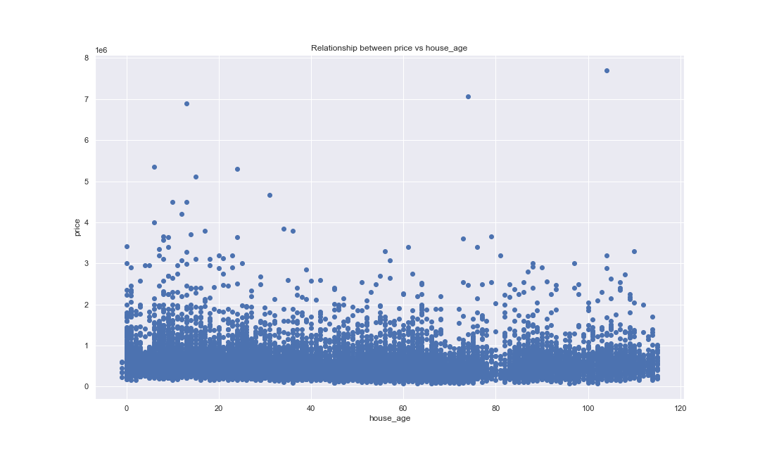
Results

Slide 7
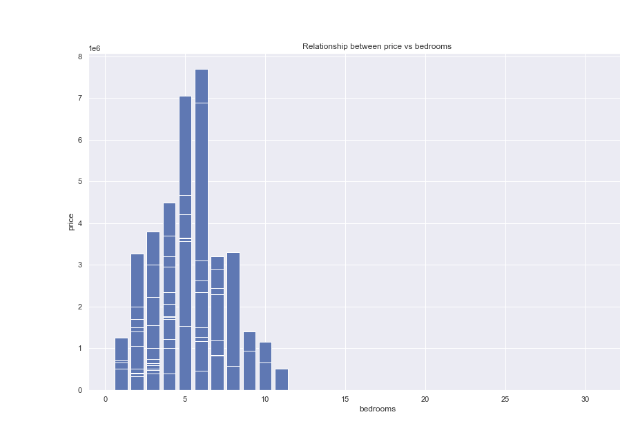
results

Slide 8
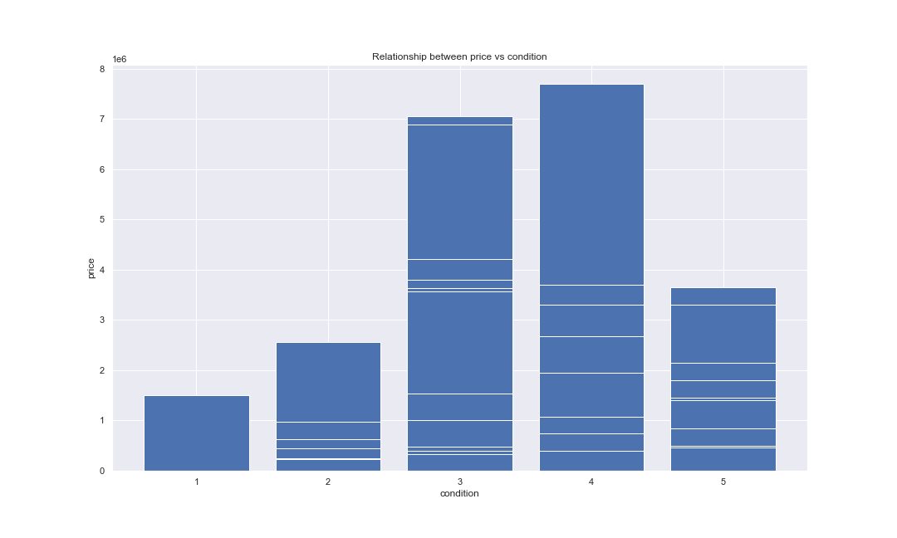
RESULTs

Slide 9
Conclusions
Generally, It seems that the larger the home area, the more pricey a house is. Roughly, many homes have a home footage of between 400 to 5000
From the above observations, it seems that houses with a relatively smaller lot area are the ones going for the highest prices. Most houses have a smaller lot area.
Generally, all houses seem to have a relatively same price regardless of its age but most of the pricey houses are not that old.
The houses with the most value have around 5 to 6 bedrooms.
Houses with the highest prices are at condition 4.This means the house is in good condition- No obvious maintenance required but neither is everything new. Appearance and utility are above the standard .

Slide 10


Recommendations
Homeowners should build houses with large living area inorder to attract higher prices for their houses.
Homeowners should be advised not to concentrate on the lot area so much ,instead have small lot areas
Inorder for homeowners to obtain maximum value for their houses, they should be relatively new.
An ideal house should have 5-6 bedrooms
Home owners should be advised to have their houses in good condition so as to fetch for higher prices.

Slide 11

Thank you !
hannah.mutua@student.moringaschool.com

